Slide 1
Mammogram
Name:
Institution:

Slide 2
Population selection
Breast cancer is among the common forms of cancer among women.
Old women are at greater risk of breast cancer
Keynoting that everyone is getting older
Women over 60 years old are likely to acquire breast cancer (Cancer Treatment Centers of America, 2019)
Only 10-15% of breast cancer is reported among women below 45 years
Notes:
Breast cancer is among the common forms of cancer among women. Old women are at greater risk of breast cancer. It is keynoting that everyone is getting older and therefore women over 60 years old are likely to acquire breast cancer (Cancer Treatment Centers of America, 2019)
Other factors that can promote breast cancer include family history, inherited genes. Also, obesity, high breast density and breast changes can increase changes of breast cancer.

Slide 3
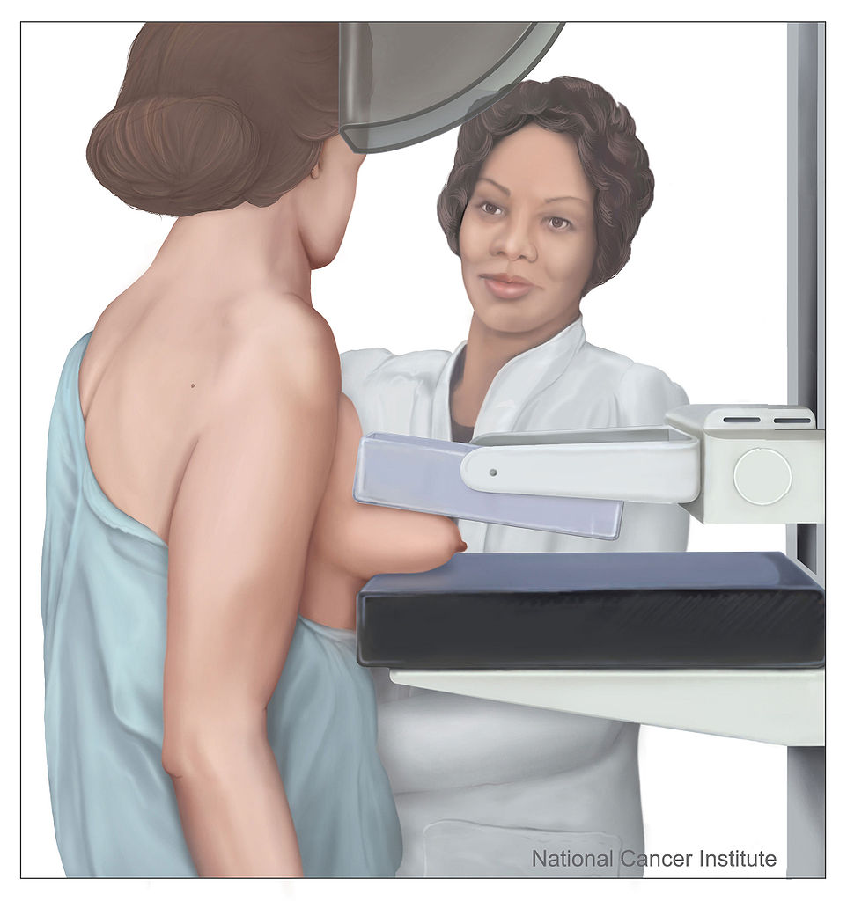
Screening introduction
A mammogram is an x-ray scan of the breast
The screening tool is utilized in detecting and diagnosing breast cancer
This tool helps in finding breast cancer early before it can be felt
Notes:
A mammogram is a screening tool which uses x-ray scan to evaluate breast cancer. The screening tool is utilized in detecting and diagnosing breast cancer.
This tool helps in finding breast cancer early before it can be felt

Slide 4
Screening Introduction Cont.
How mammogram is used
The screening utilizes a special x-ray machine
Breasts are placed on a plastic plate and pressed by another plate (Centers for Disease Control and Prevention, 2018)
The plates help in holding and flattening the breast when the X-ray is taken
The procedure is repeated severally to take side views of the breast
Notes:
Mammogram screening makes use of a special x-ray machine in which the breasts are placed on a plastic plate and pressed by another plate (Centers for Disease Control and Prevention, 2018). Usually this procedure is repeated so that different views of the breasts may be captured. The technologist should check the images collected to ensure that the procedure does not necessitate to be re-done.

Slide 5
Screening Introduction Cont.
Preparing for mammogram
Use a facility which has specialized in mammograms
It is recommended to use the same facility to help in comparing results
Take mammogram screening when breasts are not swollen to avoid incorrect results
When taking test refrain from deodorants and antiperspirants; they may interfere with images
Notes:
When preparing for a mammogram screening, one should consider going to a facility which has specialized in mammograms. It is recommended to use the same facility repeatedly since this helps in comparing results of the images taken with those taken previously. Most importantly, one should take mammogram screening when breasts are not swollen to avoid incorrect results.

Slide 6
Screening Introduction Cont.
Why mammogram was chosen
Saves lives: Detecting cancer early helps in preventing it from spreading
A mammogram is effective: the best tool for detecting breast cancer early
Provides quality results: digital mammogram provides images that can be enlarged
Enlarging helps in examining certain sections more closely (Provincial Health Services Authority, 2019)
Notes:
Mammogram provide several benefits which include saving lives by detecting cancer early thus helping to preventing it from spreading. Additionally a mammogram is an effective tools that is helpful in detecting breast cancer early. Furthermore, the use of a digital mammogram may aide in providing images that can be enlarged to assist in examining certain sections more closely (Provincial Health Services Authority, 2019).

Slide 7
Relevant group statistics
By January 2019, there were over 3.1 million women in the US with breast cancer history
In the United States, 1 out of 8 will develop breast cancer in her lifetime
About 268,600 new cases of breast cancer among women in 2019
Over 41,760 women may die from breast cancer in the US in 2019
Notes:
The rate of breast cancers have been increasing, there are about 3.1 million women in the United States who have had breast cancer. Additionally, about 1 out of 8 women in the United States is estimated to acquire breast cancer in her lifetime. About 268,600 new cases of breast cancer among women in 2019. Over 41,760 women may die from breast cancer in the United States in 2019.

Slide 8
Relevant group statistics Cont.
African-Americans women are more affected by breast cancer than white women
Incident of breast cancer has slightly increased by about 0.4 % every year
In 2018, the new cases of cancer reported were about 2 million
The risk of breast cancer doubles for women with the first-degree relative diagnosed with breast cancer
Notes:
It is keynoting that the rate of breast cancer among women in the United States have slightly increased than in 2018, the African-Americans women are more affected than their counterparts white women. Women with relatives who have been diagnosed with breast cancer are at a greater risk.

Slide 9
Impact on women health
The likelihood of women dying from breast cancer is high
Breast cancer is the second leading cause of death among women
Breast cancer impacts the reproductive function of women; chemotherapy effects (Hickey, Peate, Saunders, Friedlander, 2009)
More resources are utilized in seeking medical care
Notes:
Breast cancer has impacted women’s health differently, the cases of deaths resulting from breast cases have increased. Also, breast cancer impacts the reproductive function of women; chemotherapy effects (Hickey, Peate, Saunders, Friedlander, 2009). Women also used more finances when seeking medications to manage breast cancers.

Slide 10
Issues impacting screening
Cost
The high costs associated with mammogram screening may affect potential breast cancer patients
Knowledge and attitudes
Individuals unaware of such screening tools may be understood benefits of mammogram
Notes:
Mammogram screening may be impacted by different factors which include the high costs that are more likely to affect breast cancer patients. Additionally, individuals with now knowledge of mammogram may be hesitant to conduct screening and this can cause the cancer to spread thus increasing the damage.

Slide 11
Issues impacting screening Cont.
Controversies surrounding mammogram
Giving false-negative results
A mammogram screening may return negative results even when cancer is present
This is common in both women with dense and less dense breast (American Cancer Society, 2017)
Returning false-positive results
Mammogram screen results may appear abnormal even when cancer is not present
This is common among young women with dense breasts
Notes:
Sometimes a mammogram screening may return contradicting results. For example, it can give negative results for an individual with a breast cancer. In other cases, it can that a person who does not have cancer as being positive. These situations are common in both women with dense and less dense breast (American Cancer Society, 2017)

Slide 12
References
American Cancer Society. (2017, October 9). Limitations of Mammograms. Retrieved from https://www.cancer.org/cancer/breast-cancer/screening-tests-and-early-detection/mammograms/limitations-of-mammograms.html
Cancer Treatment Centers of America. (2019). Breast cancer. Retrieved from https://www.cancercenter.com/cancer-types/breast-cancer/risk-factors
Centers for Disease Control and Prevention. (2018, September 11). What Is a Mammogram? Retrieved from https://www.cdc.gov/cancer/breast/basic_info/mammograms.htm
Hickey, M. Peate, M., Saunders, C.M., Friedlander, M. (2009). Breast cancer in young women and its impact on reproductive function. Human Reproduction Update, 15(3), 323–339.
Provincial Health Services Authority. (2019). BC Cancer Screening. Retrieved from http://www.bccancer.bc.ca/screening/breast/get-a-mammogram/benefits-and-limitations

